Slide 1
Advanced Hands On OpenCLTM
Simon McIntosh-Smith
James Price
Includes contributions from Tom Deakin, Tim Mattson (Intel), Benedict Gaster (UWE), and many others

Slide 2
Course materials
Download the course slides, exercises and solutions:
http://www.cs.bris.ac.uk/ ~simonm/OpenCL/IWOCL_2017.zip

Slide 3
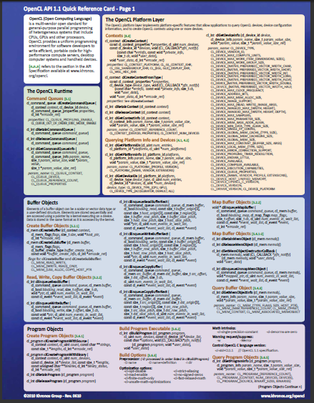
Course materials
In addition to these slides, C++ API header files, exercises and solutions, it is useful to have:
OpenCL Reference Cards
These cards will help you keep track of the API as you do the exercises:
https://www.khronos.org/ registry/cl/
The spec is also very readable and recommended to have on-hand

Slide 4
Exercise dependencies
OS X (recent)
OpenCL driver is built in
SDL2 (optional)
Linux
Any OpenCL driver (e.g. NVIDIA, AMD or Intel)
SDL2 (optional)
Windows
Windows 7 or newer
Visual Studio 2010 or newer
Any OpenCL driver (e.g. NVIDIA, AMD or Intel)

Slide 5
Remote machine
We’ll be using Bristol’s cluster (the “Zoo”): ssh user@hpc.cs.bris.ac.uk
Username (e.g): train01
Password: iwocl2017
SSH into one of the nodes to run
node20: NVIDIA Tesla K40c, Tesla K20c
node22: NVIDIA GTX 980 Ti, GTX 780 Ti
node23: NVIDIA Titan X, GTX 1080 Ti
node31: AMD Fury X, R9 290 X
node32: AMD RX 480

Slide 6
A quick recap of OpenCL

Slide 7
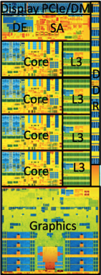
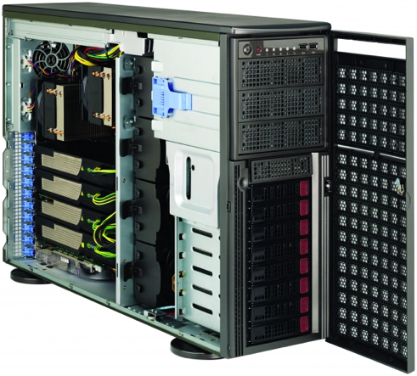
It’s a Heterogeneous world
A modern computing platform includes:
One or more CPUs
One of more GPUs
DSP processors
Accelerators
… others?
From integrated CPUs in smartphones, tablets and laptops through high-end desktops and servers with discrete GPUs
OpenCL lets Programmers write a single portable program that uses ALL resources in the heterogeneous platform
Notes:
Die photo is Intel 5th gen Haswell quad core with GT3e IRIS graphics.
From http://www.anandtech.com/show/7744/intel-reveals-new-haswell-details-at-isscc-2014
Samsung® Exynos 5 is a Dual core ARM A15 1.7GHz, Mali T604 GPU

Slide 8
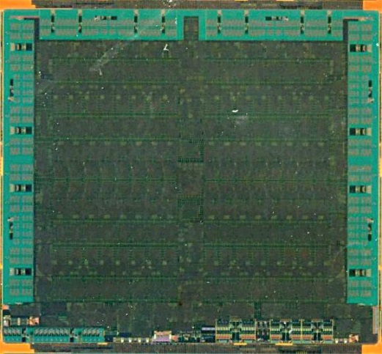
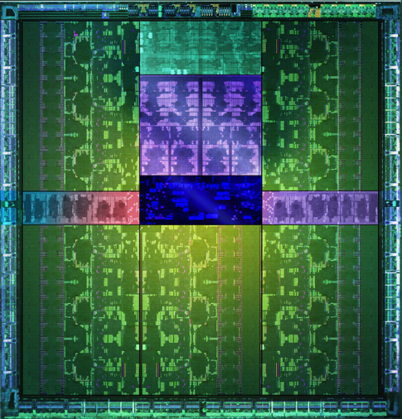
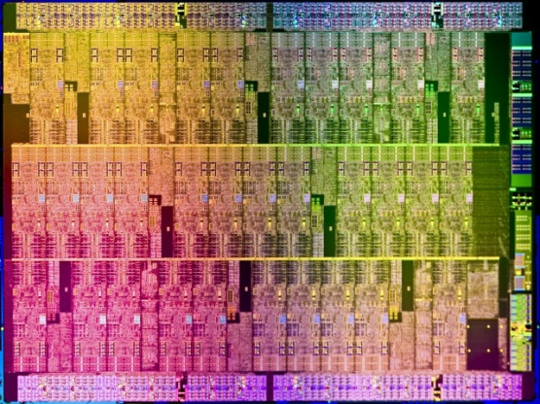
Microprocessor trends
Individual processors have many (possibly heterogeneous) cores.
32 cores
16 wide SIMD
10 cores
16 wide SIMD
61 cores
16 wide SIMD
15 cores
192 wide SIMD
AMD® Tahiti
Intel® Xeon Phi™ coprocessor
NVIDIA® Tesla® K40
The Heterogeneous many-core challenge:
How are we to build a software ecosystem for the Heterogeneous many core platform?
Third party names are the property of their owners.

Slide 9
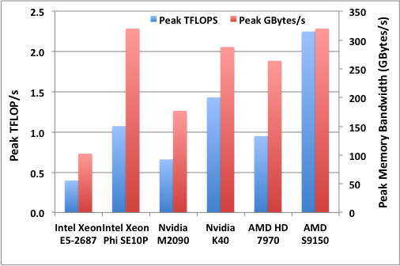
Many-core performance potential
5.7X FLOP/s speedup
3.1X memory bandwidth
16 cores of Sandy Bridge at 3.1 GHz

Slide 10
Unlocking this potential
We need efficient, expressive, parallel programming languages
We also need cross-platform standards
Ideally not just for HPC so that they have sufficient momentum for the long term
OpenCL is the only parallel programming language that meets all these many-core requirements today

Slide 11

Industry Standards for Programming Heterogeneous Platforms
GPUs
Increasingly general purpose data-parallel computing
CPUs
Multiple cores driving performance increases
Emerging Intersection
Graphics APIs and Shading Languages
Multi-processor programming – e.g. OpenMP
Heterogeneous Computing
OpenCL – Open Computing Language
Open, royalty-free standard for portable, parallel programming of heterogeneous parallel computing CPUs, GPUs, and other processors

Slide 12




























OpenCL Working Group within Khronos
Diverse industry participation
Processor vendors, system OEMs, middleware vendors, application developers.
OpenCL became an important standard upon release by virtue of the market coverage of the companies behind it.
Third party names are the property of their owners.

Slide 13
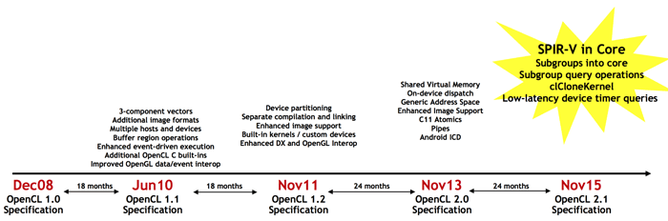
OpenCL progress
New OpenCL C++ kernel language based on a subset of C++14
Significantly enhanced programmer productivity and code performance
OpenCL C still supported to preserve kernel code investment
Support for the new Khronos SPIR-V intermediate language in core
SPIR-V now used by both OpenCL 2.1 and the new Vulkan graphics API
Runs on any OpenCL 2.0-capable hardware
Only driver update required

Slide 14



OpenCL progress v2.2 - Top to Bottom C++
Single Source C++ Programming
Full support for features in C++14-based Kernel Language
API and Language Specs
Brings C++14-based Kernel Language into core specification
OpenCL C++ Kernel Language
SPIR-V 1.2 with C++ support
SYCL 2.2 for single source C++
Portable Kernel Intermediate Language
Support for C++14-based kernel language e.g. constructors/destructors
SPIR-V in Core
Subgroups into core
Subgroup query operations
clCloneKernel
Low-latency device timer queries
Device partitioning
Separate compilation & linking
Enhanced image support
Built-in kernels / custom devices
Enhanced DX & GL Interop
Shared Virtual Memory
On-device dispatch
Generic Address Space
Enhanced Image Support
C11 Atomics
Pipes
Android ICD
3-component vectors
Additional image formats
Multiple hosts and devices
Buffer region operations
Enhanced event-driven execution
Additional OpenCL C built-ins
Improved OpenGL data/event interop
Dec08
18 months
Jun10
18 months
Nov11
24 months
Nov13
24 months
Nov15
18 months
May17
OpenCL 1.0 Specification
OpenCL 1.1 Specification
OpenCL 1.2 Specification
OpenCL 2.0 Specification
OpenCL 2.1 Specification
OpenCL 2.2 Specification

Slide 15
Important OpenCL concepts

Slide 16
OpenCL Platform Model
…
…
…
…
…
…
…
Processing Element
…
…
Host
…
…
…
…
…
…
Compute Unit
OpenCL Device
One Host and one or more OpenCL Devices
Each OpenCL Device is composed of one or more Compute Units
Each Compute Unit is divided into one or more Processing Elements
Memory divided into host memory and device memory

Slide 17

An N-dimensional domain of work-items
Global Dimensions:
1024x1024 (whole problem space)
Local Dimensions:
128x128 (work-group, executes together)
1024
Synchronization between work-items possible only within work-groups:
barriers and memory fences
1024
Cannot synchronize between work-groups within a kernel
Choose the dimensions that are “best” for your algorithm

Slide 18
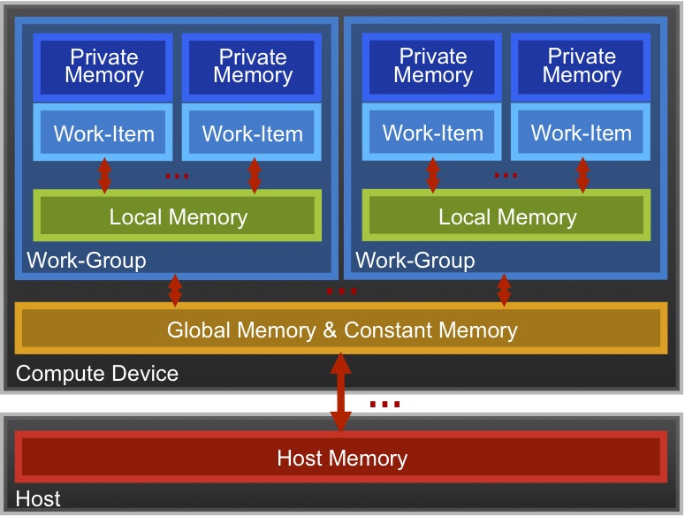
OpenCL Memory model
Private Memory
Per work-item
Local Memory
Shared within a
work-group
Global Memory /Constant Memory
Visible to all
work-groups
Host memory
On the CPU
Memory management is explicit: You are responsible for moving data from
host → global → local and back

Slide 19
The basic platform and runtime APIs in OpenCL (using C)
CPU
GPU
Context
Programs
Kernels
Memory Objects
Command Queues
Programs
dp_mul
Buffers
Images
__kernel void
dp_mul(global const float *a,
global const float *b,
global float *c)
{
int id = get_global_id(0);
c[id] = a[id] * b[id]; }
dp_mul
CPU program binary
arg [0] value
In Order
Queue
Out of Order
Queue
arg [0] value
In Order
Queue
Out of Order
Queue
arg[0] value
arg [1] value
arg [1] value
dp_mul
GPU program binary
arg[1] value
arg [2] value
arg [2] value
arg[2] value
GPU
Compute Device

Slide 20
Host programs
The host program is the code that runs on the host to:
Setup the environment for the OpenCL program
Create and manage kernels
5 main steps in all host programs:
Define the platform … platform = context+queues+devices
Create and Build the program (dynamic library of kernels)
Setup memory objects
Define the kernels (attach arguments to kernel functions)
Submit commands … transfer memory objects and execute kernels

Slide 21
The C++ Interface
Khronos has defined a common C++ header file containing a high level interface to OpenCL, cl2.hpp
This interface is dramatically easier to work with¹
Key features:
Uses common defaults for the platform and command-queue, saving the programmer from extra coding for the most common use cases
Simplifies the basic API by bundling key parameters with the objects rather than requiring verbose and repetitive argument lists
Ability to “call” a kernel from the host, like a regular function
Error checking can be performed with C++ exceptions
¹ especially for C++ programmers…

Slide 22
C++ interface example
#define N 1024
int main(void) {
vector<float> h_a(N), h_b(N), h_c(N);
// initialize these host vectors…
Buffer d_a, d_b, d_c;
Context context(CL_DEVICE_TYPE_DEFAULT);
CommandQueue queue(context);
Program program(context,
loadprogram(“vadd.cl”), true);
// Create the kernel functor
KernelFunctor<Buffer, Buffer, Buffer>
vadd(program, “vadd”);
// Create buffers
// True indicates CL_MEM_READ_ONLY
// False indicates CL_MEM_READ_WRITE
d_a = Buffer(context, h_a.begin(), h_a.end(), true);
d_b = Buffer(context, h_b.begin(), h_b.end(), true);
d_c = Buffer(context, CL_MEM_WRITE_ONLY,
sizeof(float) * N);
// Enqueue the kernel
vadd(EnqueueArgs(queue, NDRange(N)),
d_a, d_b, d_c);
copy(queue, d_c, h_c.begin(), h_c.end());
}
Note: The default context and command queue are used when we don't specify one in the function calls. The code here also uses the default device, so these cases are the same.

